Slide 1
Recommander System using Deep Learning

Slide 2
index
추천 시스템
개요
방법론
딥러닝 활용
RBM
CDL
CNN

Slide 3
추천 시스템
정보 필터링 (IF) 기술의 일종으로, 특정 사용자가 관심을 가질만한 정보 (영화, 음악, 책, 뉴스, 이미지, 웹 페이지 등)를 추천하는 것이다.
추천 시스템에는 협업 필터링 기법을 주로 사용한다. 소셜 북마크 사이트에서 링크를 사람들에게 추천하고 무비렌즈 데이터 세트에서 영화를 추천하는 방법등이 이에 속한다.
wikipedia

Slide 4
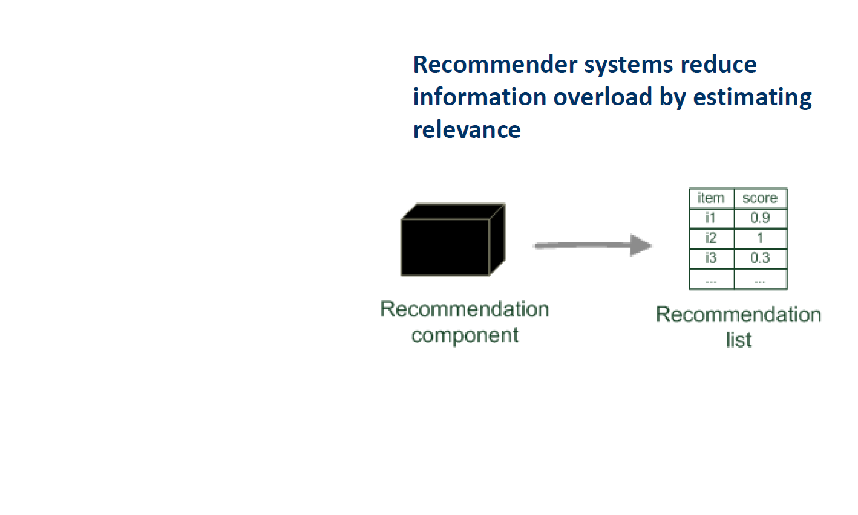
방법론

Slide 5
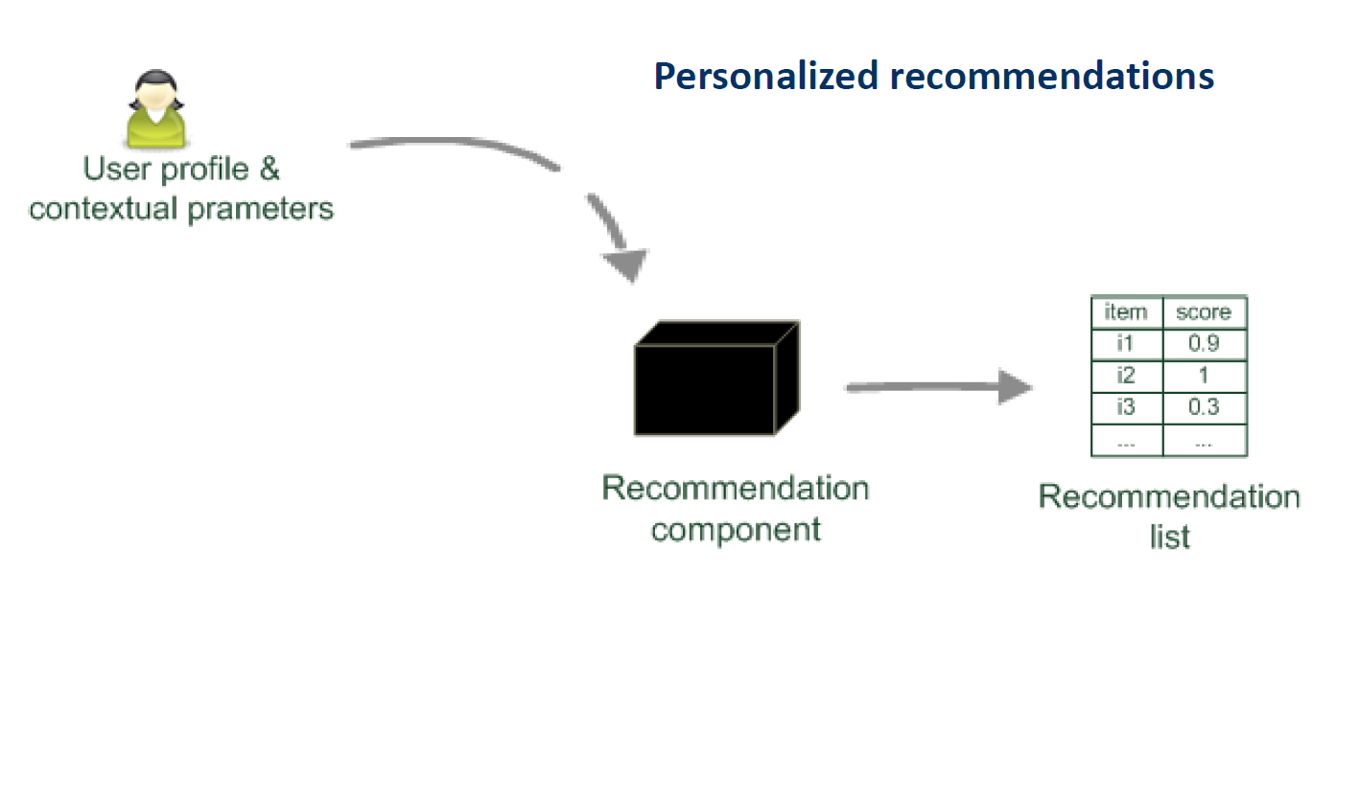
방법론

Slide 6
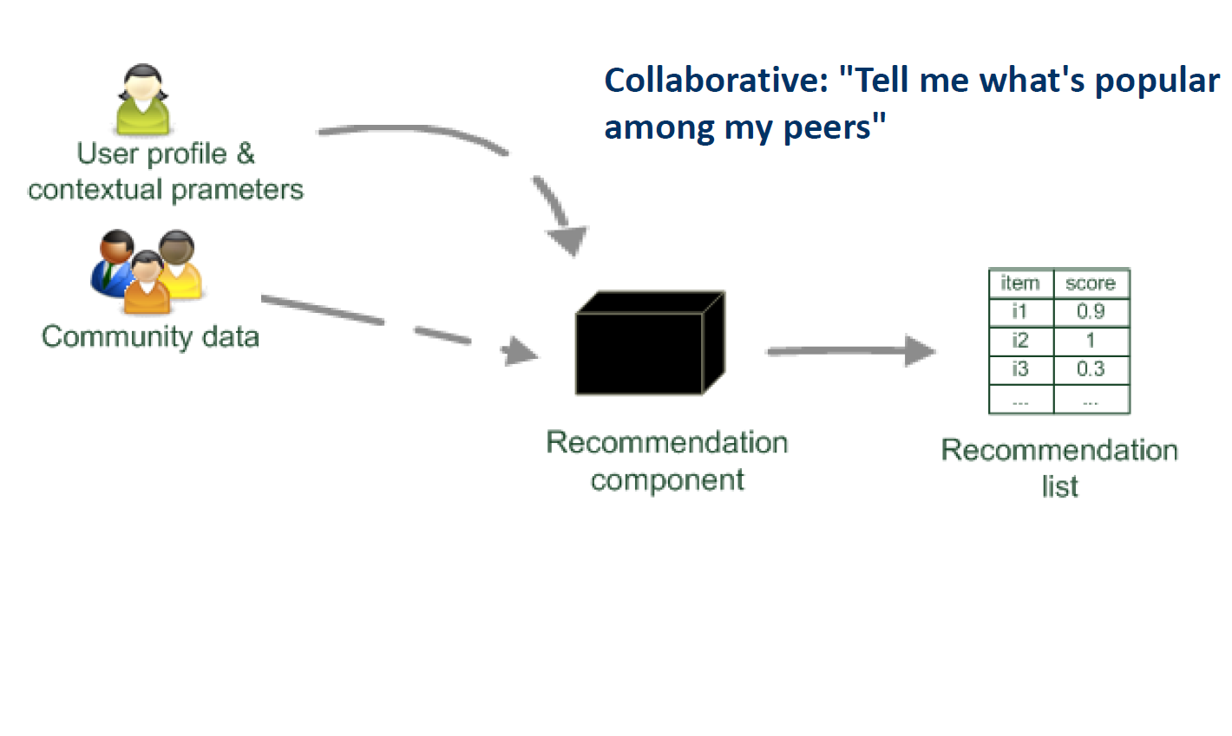
방법론

Slide 7
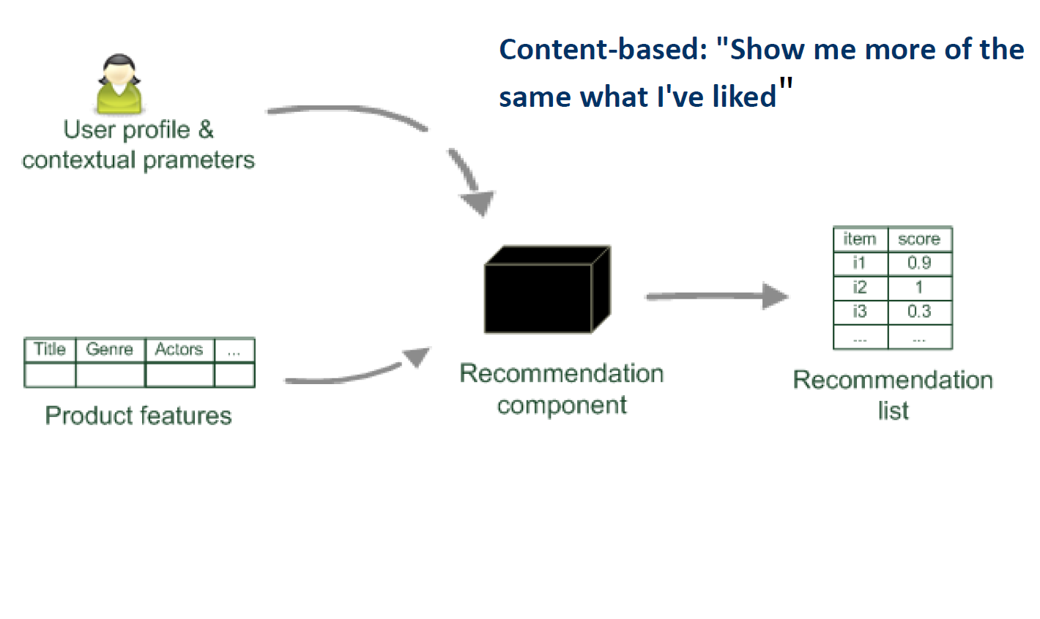
방법론

Slide 8
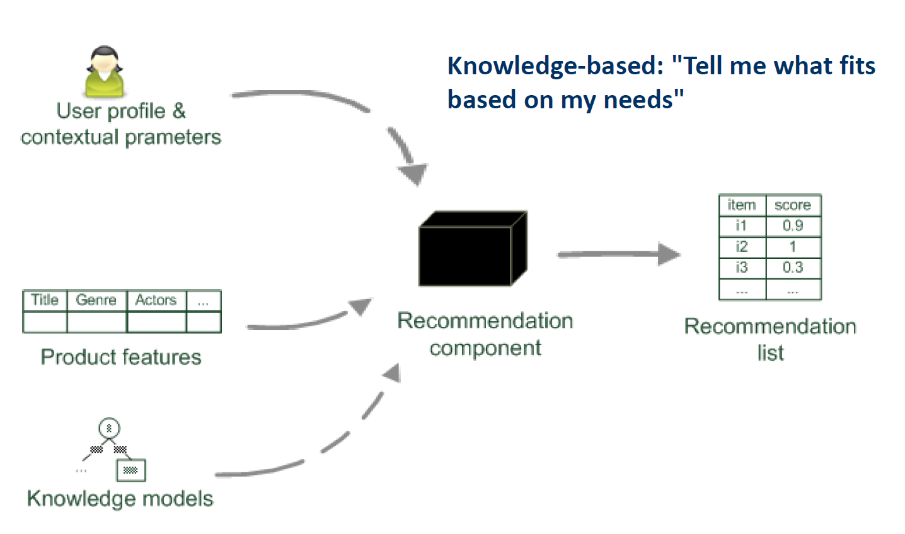
방법론

Slide 9
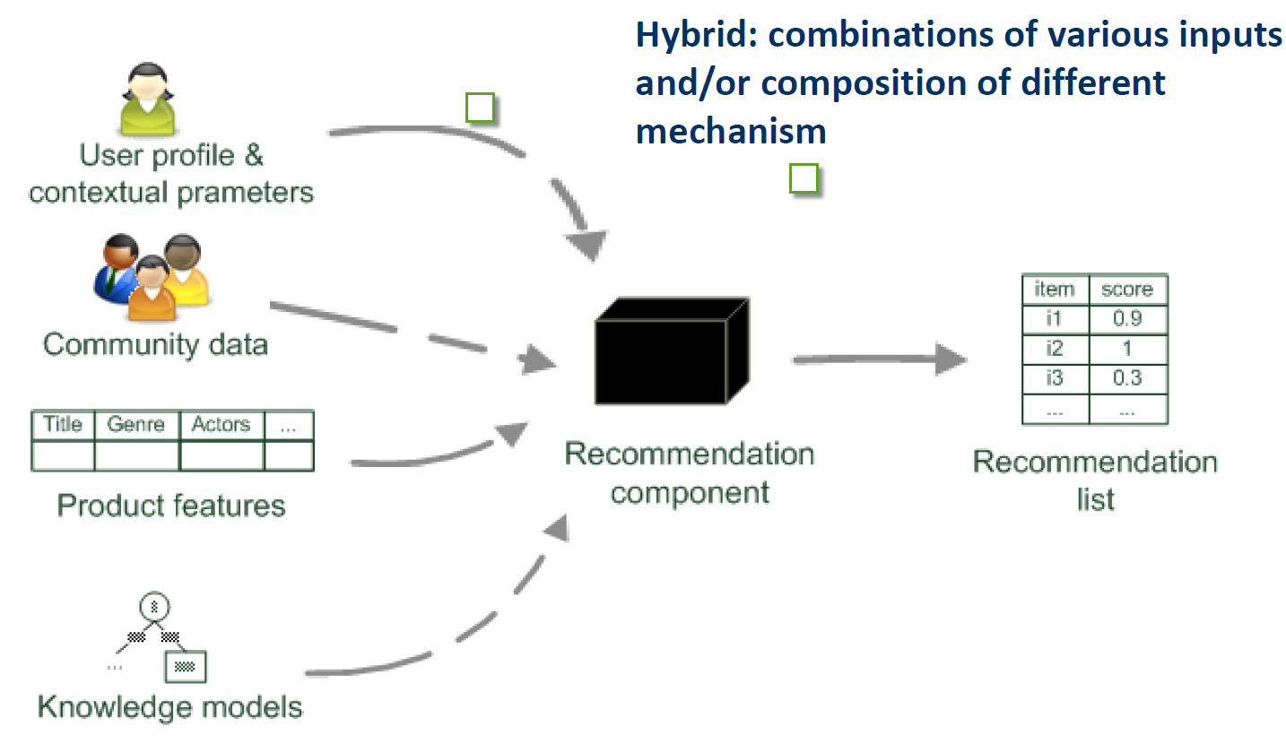
방법론

Slide 10
정리 하자면…
 | Pros | Cons
Collaborative | No Knowledge engineering effort Serendipity of results Learns market segments | Requires some form of rating feedback, cold start for new users and new items
Content-Based | No community required, comparison between items possible | Content descriptions necessary, cold start for new users, no surprises
Knowledge-Based | Deterministic recommendations, assured quality, no coldstart, can resemble sales dialogue | Knowledge engineering effort to bootstrap, basically static, does not react to short‐term trends

Slide 11
그리고 더 자세한 것들은….
http://www.slideshare.net/xamat/recommender-systems-machine-learning-summer-school-2014-cmu
http://www.slideshare.net/ssuser2fe594/1-ppt-33990067
http://www.slideshare.net/springloops/collaborative-filtering-23732558?related=1
http://www.slideshare.net/kwnam4u/02-41434707?related=2
http://www.kdd.org/kdd2014/tutorials/KDD%20-%20The%20Recommender%20Problem%20Revisited.pdf

Slide 12
RBM
http://www.cs.toronto.edu/~rsalakhu/papers/rbmcf.pdf
Restricted Boltzmann Machines for Collaborative Filtering
볼프만 머신을 이용한 협업필터링

Slide 13
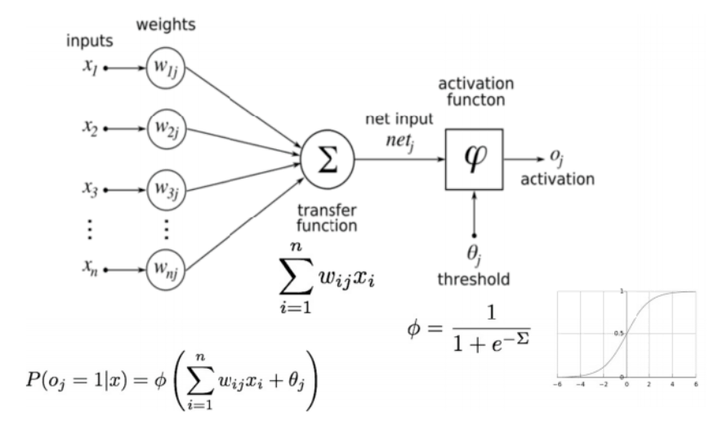
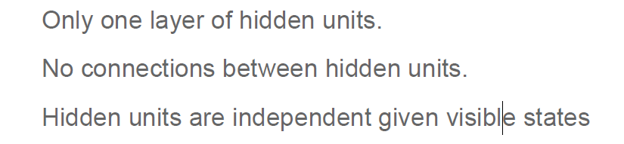
RBM
Each unit is a state that can be active or not active
Each input to a unit is associated to a weight
The transfer function Sigma Calculates a score for every unit based on the weighted sum of inputs
Score is passed to the activation function PI that calculates the probability of the unit to be active
Restrict the connection to make learning easier

Slide 14
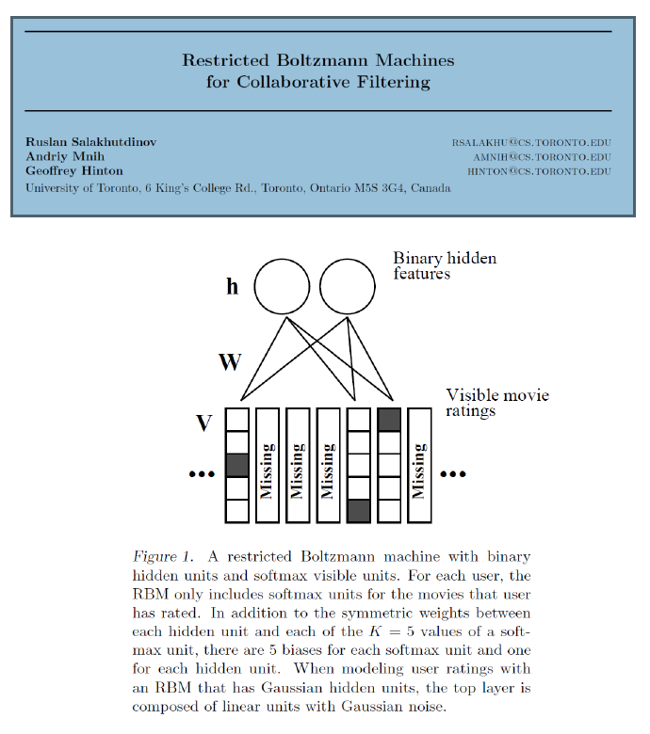
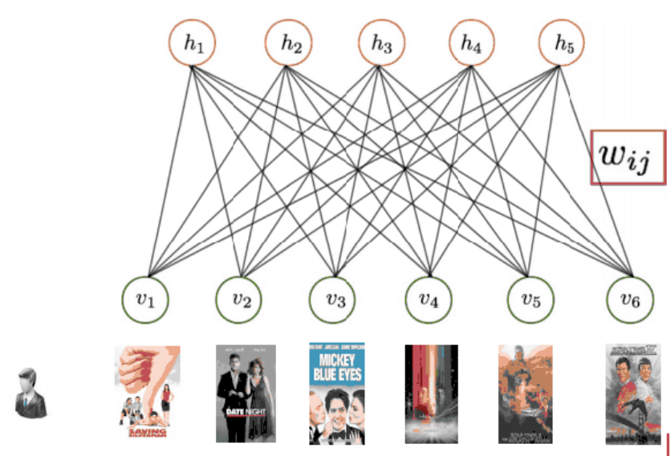
RBM for Recommendations
Each Visible unit = an item
Num. of hidden units a is parameter
In Training Phase, for each user:
If user rated item, vi is activated
Activation states of vi = inputs to hj
Based on activation, hj is computed
Activation state of hj becomes input to vi
Activation state of vi is recalculated
Difference between current and past
activation state for vi used to update weights
wij and thresholds
In Prediction phase :
For the items of the user the vi are activated
Based on this the state of the hj is computed
The activation of hj is used as input to
recompute the state of vi
Activation probabilities are used to recommend items

Slide 15

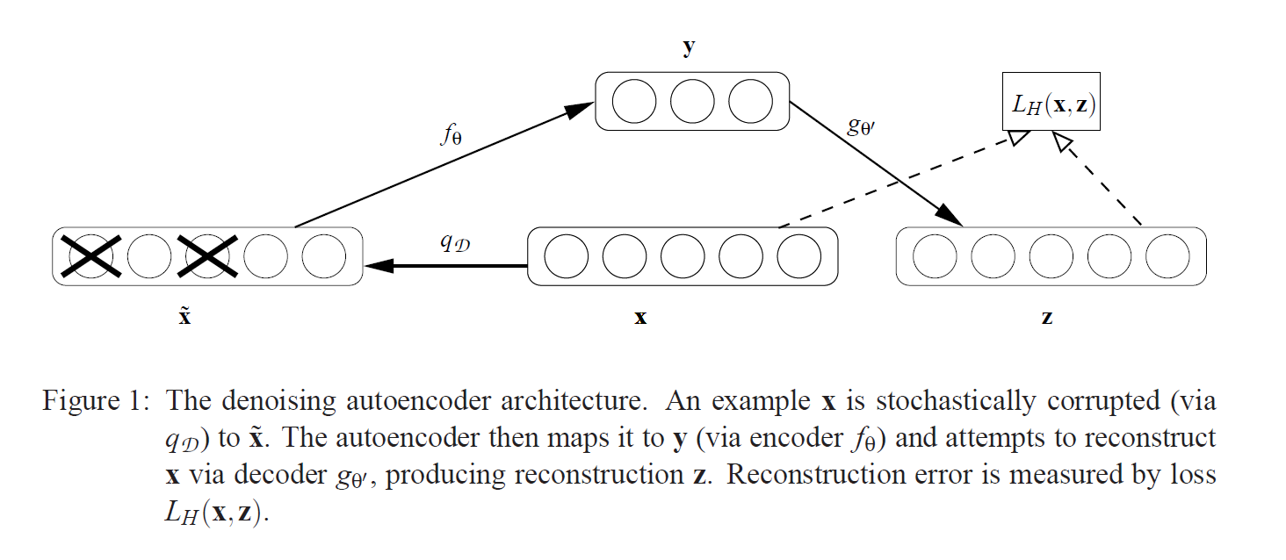
CDL
COLLABORATIVE DEEP LEARNING
Based on Stacked Denosing AutoEncoder

Slide 16
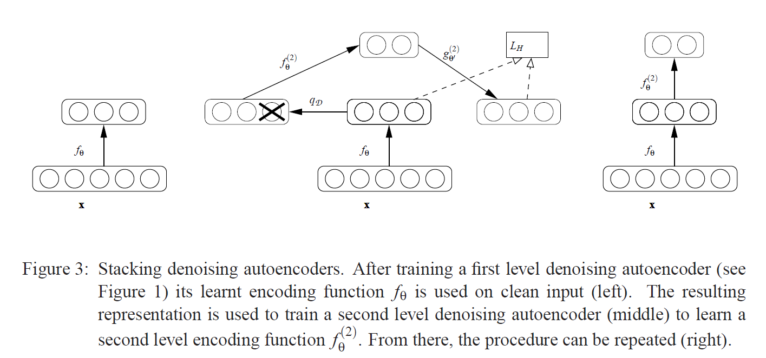
SDAE

Slide 17
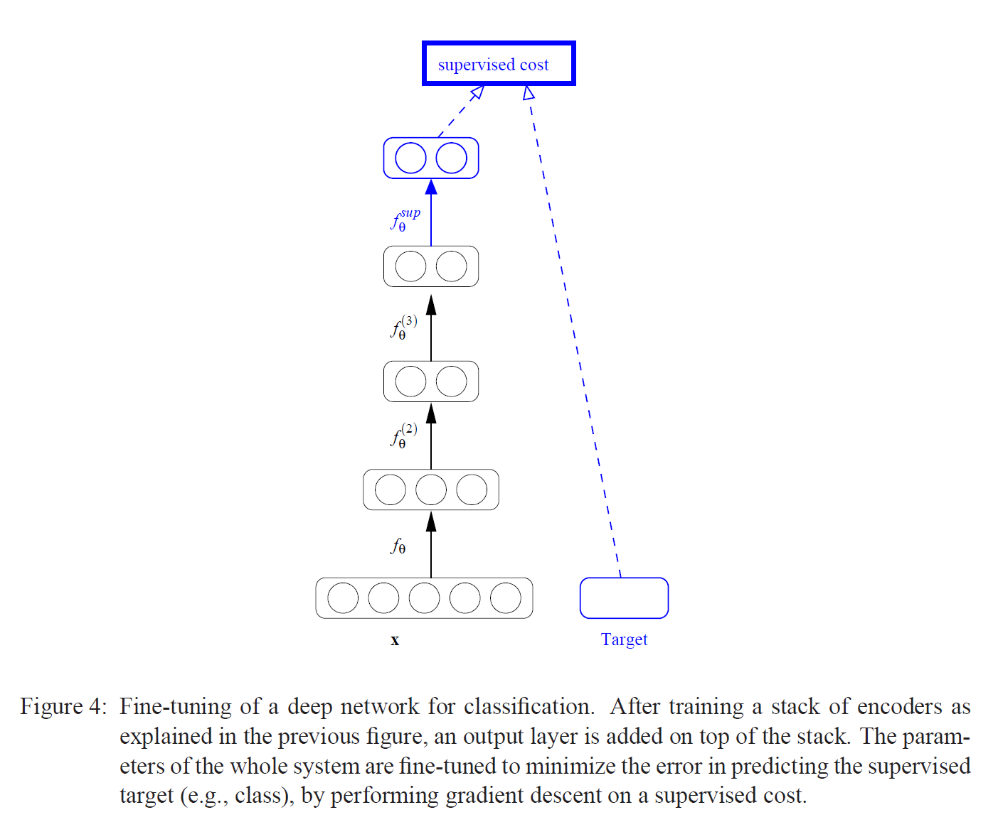
SDAE

Slide 18
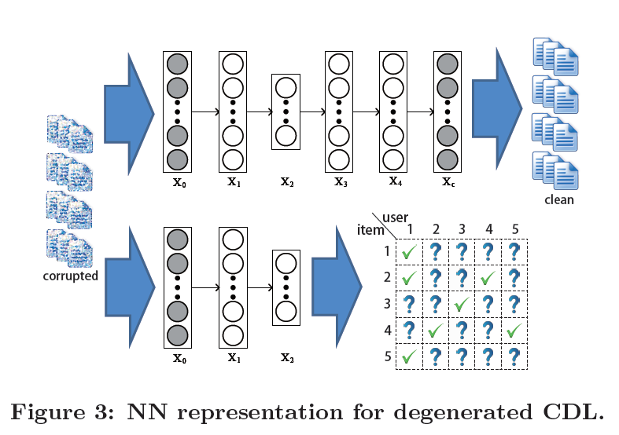
CDL

Slide 19
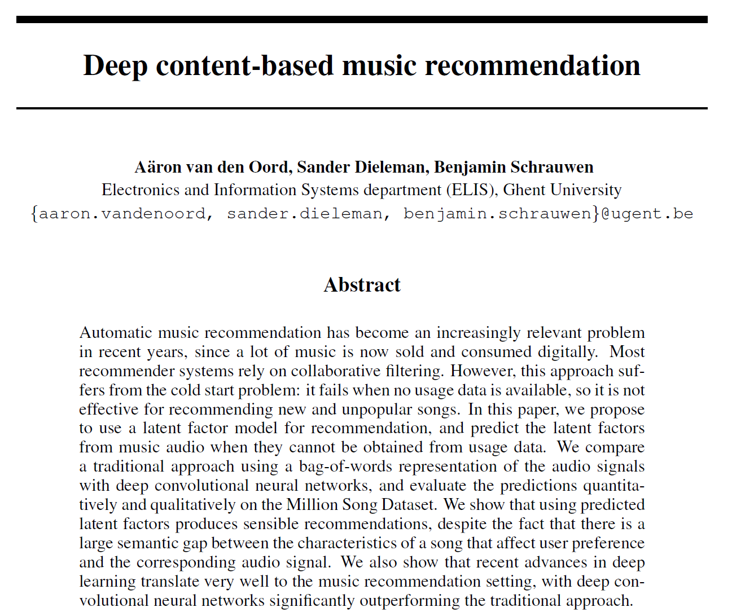
CNN
https://www.youtube.com/watch?v=TjqtotTdlgY
http://benanne.github.io/2014/08/05/spotify-cnns.html
Content Base Recommandewr System

Slide 20
CNN
Latent Factor
We tried to tackle the problem of predicting listening preferences from audio signals by training a regression model to predict the latent representations of songs that were obtained from a collaborative filtering model.

Slide 21
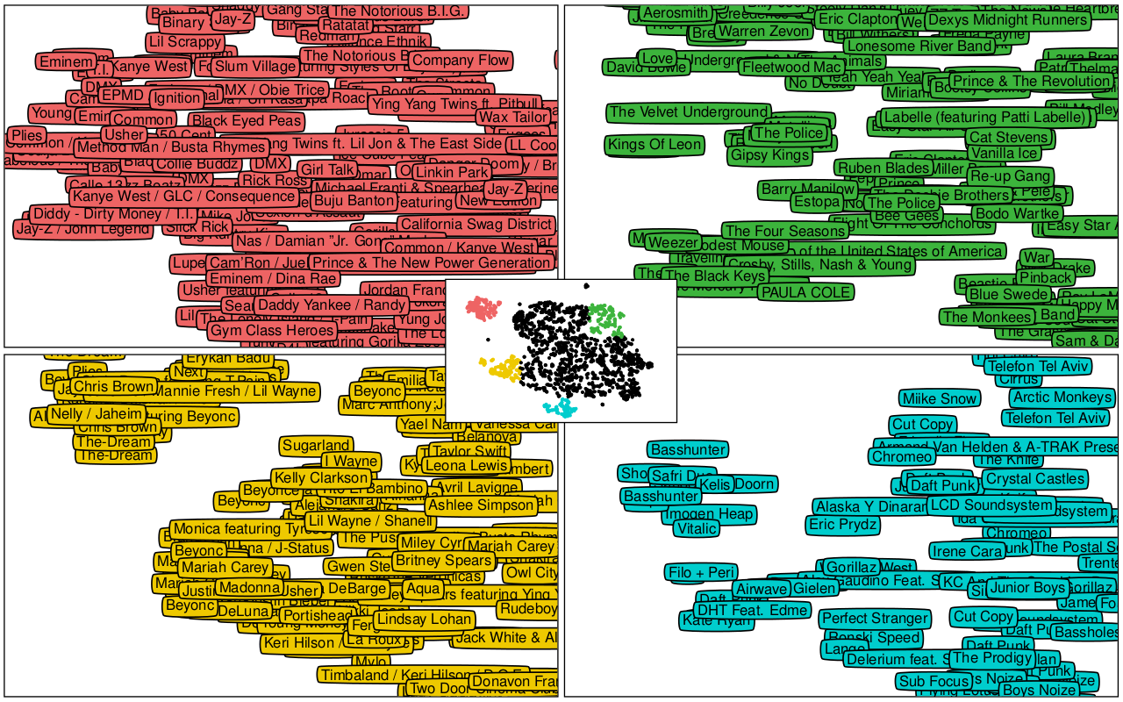
CNN
Latent Space

Slide 22
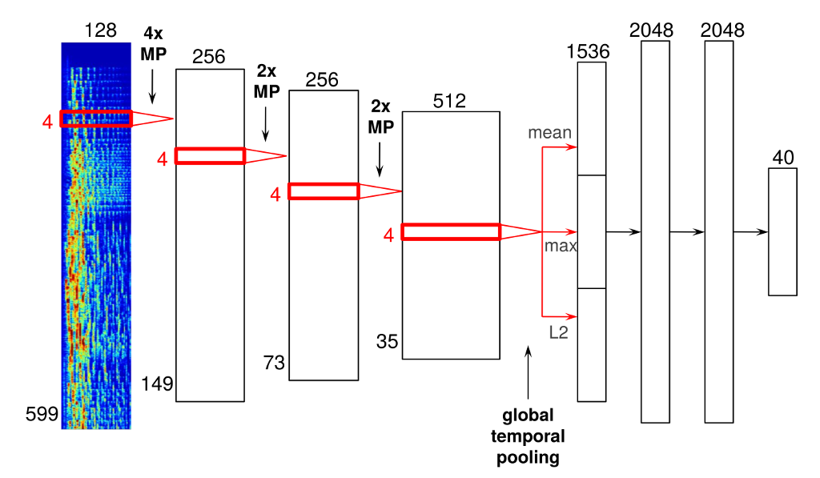
CNN
Time axis

Slide 23
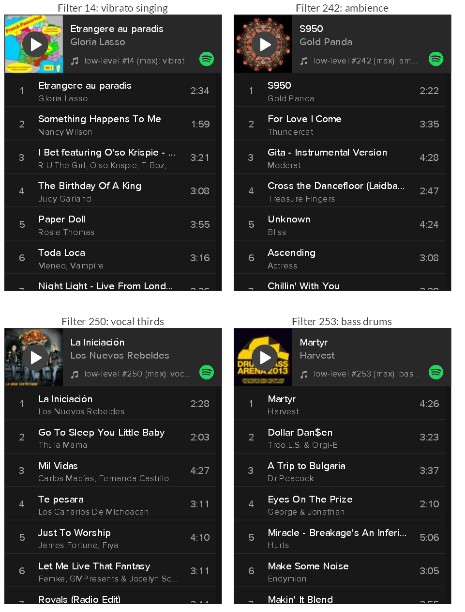
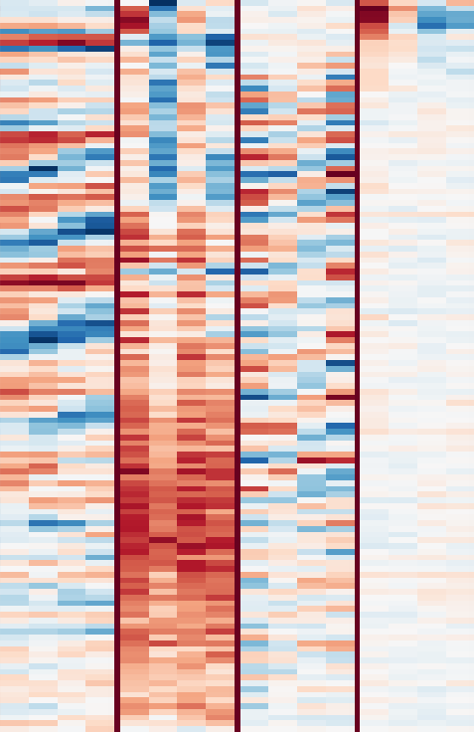
CNN

